Slide 1
Oracle Schema Objects
views, sequences, synonyms, indexes

Slide 2
OVERVIEW
View
view is a logical representation of data from one or more tables or views.
query stored in the database.
Oracle 11g allows you to create constraints on the views and restrict the operations on views
Sequence
use a sequence to generate artificial keys or serial numbers
Synonyms
Synonyms provide aliases for objects
Index
Indexes provide an access path to the table data
Several types of indexes can be deployed to enhance the performance of queries

Slide 3
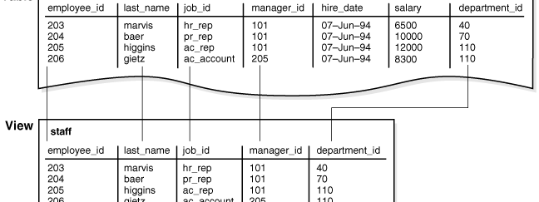
Creating and Modifying Views
bird eye view

Slide 4
CREATE VIEW
Use the CREATE VIEW statement to define a view, which is a logical table based on one or more tables or views.
A view contains no data itself.
The tables upon which a view is based are called base tables.
Privilege
To create a view in your own schema, you must have the CREATE VIEW system privilege.
To create a view in another user's schema, you must have the CREATE ANY VIEW system privilege.
Or Replace
Specify OR REPLACE to re-create the view if it already exists.
You can use this clause to change the definition of an existing view without dropping, re-creating, and regranting object privileges previously granted on it.
If the view does not exist, CREATE OR REPLACE VIEW is the same as CREATE VIEW.
If the view does exist, CREATE OR REPLACE VIEW is the same as ALTER VIEW.

Slide 5
CREATE VIEW Syntax
CREATE VIEW test.v AS SELECT * FROM t;
CREATE
[OR REPLACE]
[ALGORITHM = {UNDEFINED | MERGE | TEMPTABLE}]
[DEFINER = { user | CURRENT_USER }]
[SQL SECURITY { DEFINER | INVOKER }]
VIEW view_name [(column_list)]
AS select_statement
[WITH [CASCADED | LOCAL] CHECK OPTION]
CREATE VIEW sales_staff AS SELECT empno, ename, deptno FROM emp WHERE deptno = 10 WITH CHECK OPTION CONSTRAINT sales_staff_cnst;

Slide 6
constraint and views
The query that defines the sales_staff view references only rows in department 10. Furthermore, the CHECK OPTION creates the view with the constraint (named sales_staff_cnst) that INSERT and UPDATE statements issued against the view cannot result in rows that the view cannot select.
Sales_staff view reference only rows in department 10
the CHECK OPTION creates the view with the constraint (named sales_staff_cnst) that INSERT and UPDATE statements issued against the view cannot result in rows that the view cannot select. FOR EXAMPLE
INSERT INTO sales_staff VALUES (7584, 'OSTER', 10); OKAY
INSERT INTO sales_staff VALUES (7591, 'WILLIAMS', 30); ERROR
CREATE VIEW sales_staff AS SELECT empno, ename, deptno FROM emp WHERE deptno = 10 WITH CHECK OPTION CONSTRAINT sales_staff_cnst;

Slide 7
VIEWS are updateable
If the VIEW is constructed specifying the WITH READ ONLY clause, which prevents any updates, inserts, or deletes from being done to the base table through the view. If no WITH clause is specified, the view, with some restrictions, is inherently updatable.

Slide 8
join views
CREATE VIEW division1_staff AS
SELECT ename, empno, job, dname
FROM emp, dept
WHERE emp.deptno IN (10, 30)
AND emp.deptno = dept.deptno;
More than one base table is used to create the view

Slide 9
Expansion of Defining Queries at View Creation Time
When a view is created, Oracle Database expands any wildcard (*) in a top-level view query into a column list
CREATE VIEW dept AS SELECT * FROM scott.dept;
is expanded to
SELECT "DEPTNO", "DNAME", "LOC" FROM scott.dept;

Slide 10
Replacing Views
To replace a view, you must have all of the privileges required to drop and create a view
you cannot use an ALTER VIEW statement to change the definition of a view
You can replace views in the following ways:
You can drop and re-create the view.
You can redefine the view with a CREATE VIEW statement that contains the OR REPLACE clause.
Before replacing a view, consider the following effects:
Replacing a view replaces the view definition in the data dictionary. All underlying objects referenced by the view are not affected.
If a constraint in the CHECK OPTION was previously defined but not included in the new view definition, the constraint is dropped.
All views dependent on a replaced view become invalid (not usable).

Slide 11
Using Views in Queries
SELECT * FROM Division1_staff_view;
INSERT INTO sales_staff VALUES (7954, 'OSTER', 30);
Restrictions on DML operations for views:
If a view is defined by a query that contains SET or DISTINCT operators, a GROUP BY clause, or a group function, then rows cannot be inserted into, updated in, or deleted from the base tables using the view
If a view is defined with WITH CHECK OPTION, a row cannot be inserted into, or updated in, the base table (using the view), if the view cannot select the row from the base table.
If a NOT NULL column that does not have a DEFAULT clause is omitted from the view, then a row cannot be inserted into the base table using the view.

Slide 12
Key-Preserved Tables
CREATE TABLE dept (
deptno NUMBER(4) PRIMARY KEY,
dname VARCHAR2(14),
loc VARCHAR2(13));
CREATE TABLE emp (
empno NUMBER(4) PRIMARY KEY,
ename VARCHAR2(10),
job VARCHAR2(9),
mgr NUMBER(4),
sal NUMBER(7,2),
comm NUMBER(7,2),
deptno NUMBER(2),
FOREIGN KEY (DEPTNO) REFERENCES DEPT(DEPTNO));
CREATE VIEW emp_dept AS
SELECT emp.empno, emp.ename, emp.deptno, emp.sal, dept.dname, dept.loc FROM emp, dept
WHERE emp.deptno = dept.deptno
AND
dept.loc IN
('DALLAS', 'NEW YORK', 'BOSTON');
Employee table is a key-preserved table but dept is not.
A table is key-preserved if every key of the table can also be a key of the result of the join. So, a key-preserved table has its keys preserved through a join.

Slide 13
Join view & UPDATE Statements
UPDATE emp_dept //OKAY
SET sal = sal * 1.10
WHERE deptno = 10;
UPDATE emp_dept
SET loc = 'BOSTON'
WHERE ename = 'SMITH';
This statement fails with an error (ORA-01779 cannot modify a column which maps to a non key-preserved table), because it attempts to modify the base dept table, and the dept table is not key-preserved in the emp_dept view
In general, all updatable columns of a join view must map to columns of a key-preserved table

Slide 14
Join view & delete Statements
You can delete from a join view provided there is one and only one key-preserved table in the join
DELETE FROM emp_dept //OKAY
WHERE ename = 'SMITH';
This DELETE statement on the emp_dept view is legal because it can be translated to a DELETE operation on the base emp table, and because the emp table is the only key-preserved table in the joi

Slide 15
Join view & INSERT Statements
INSERT INTO emp_dept (ename, empno, deptno) //OKAY
VALUES ('KURODA', 9010, 40);
This statement works because only one key-preserved base table is being modified (emp), and assume that 40 is a valid deptno in the dept table (thus satisfying the FOREIGN KEY integrity constraint on the emp table).
INSERT INTO emp_dept (ename, empno, deptno) //NOT OKAY
VALUES ('KURODA', 9010, 77);
the FOREIGN KEY integrity constraint on the emp table is violated (because there is no deptno 77).

Slide 16
Altering & dropping Views
ALTER VIEWS
You use the ALTER VIEW statement only to explicitly recompile a view that is invalid. If you want to change the definition of a view (OR REPLACE)
ALTER VIEW test_view compile;
ALTER VIEW hr.test_view
ADD CONSTRAINT pk_test_view
PRIMARY KEY (C1) DISABLE NOVALIDATE;
DROP VIEWS
You can drop any view contained in your schema
To drop a view in another user's schema, you must have the DROP ANY VIEW system privilege
DROP VIEW emp_dept;

Slide 17
Other stuff
Within a database, base tables and views share the same namespace, so a base table and a view cannot have the same name.
CREATE FORCE VIEW AS ...; FORCE CREATION WITH ERRORS

Slide 18
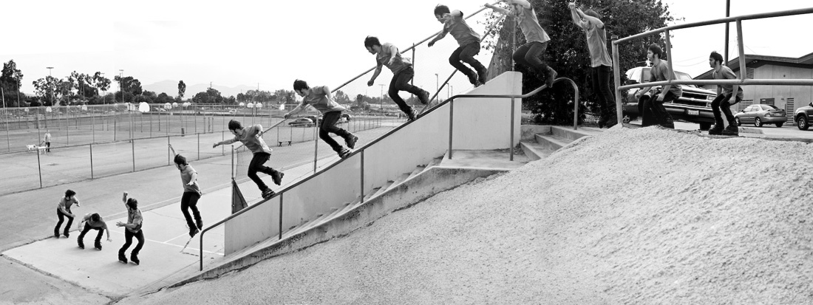
Creating and Managing Sequences
1, 2, 3, … n

Slide 19
Creating and dropping Sequences
START WITH: Defines the first number that the sequence will generate. The default is MAXVALUE for descending sequences, which is −1, and MINVALUE for ascending sequences, which is 1. INCREMENT BY: Defines the increase or decrease amount for subsequently generated numbers. To specify a decreasing sequence, use a negative INCREMENT BY value. The default is 1. MINVALUE: Defines the lowest number the sequence will generate. This is the bounding value in a decreasing sequence. The default MINVALUE is NOMINVALUE, which evaluates to 1 for an increasing sequence and to −10²⁶ for a decreasing sequence. MAXVALUE: Defines the largest number that the sequence will generate. This is the bounding value in the default, increasing sequence. The default MAXVALUE is the NOMAXVALUE, which evaluates to 10²⁷ for an increasing sequence and to −1 for a decreasing sequence. CYCLE: Configures the sequence to repeat numbers after reaching the bounding value. NOCYCLE: Configures the sequence to not repeat numbers after reaching the bounding value. This is the default. When you try to generate MAXVALUE+1, an exception will be raised. CACHE: Defines the size of the block of sequence numbers held in memory. The default is 20. NOCACHE: Forces the data dictionary to be updated for each sequence number generated, guaranteeing no gaps in the generated numbers but decreasing the performance of the sequence.
An Oracle sequence is a named sequential-number generator.
Sequence numbers are serial numbers incremented with a specific interval.
Sequences are often used for artificial keys or to order rows that otherwise have no order
CREATE SEQUENCE hr.employee_identity START WITH 2055;
Drop sequence hr.employee_identity;

Slide 20
Using sequences
SELECT emp_seq.nextval FROM dual; NEXTVAL ---------- 1 SELECT emp_seq.currval FROM dual; CURRVAL ---------- 1
sequence_name.nextval;
sequence_name.currval;
Sequence Initialization
The sequence is initialized in the session when you select the NEXTVAL from the sequence
Using CURRVAL before you initializing you get an ERROR

Slide 21
Use sequences in dml
Sequences can be used in the SET clause of the UPDATE statement to assign a value to a column in an existing row.
They can be used in the VALUES clause of the INSERT statement also.
In Oracle 11g, you can also assign the value of a sequence to a variable. Here is an example using a small PL/SQL block:
SQL> VARIABLE v1 NUMBER SQL> begin 2 :v1 := emp_seq.nextval; 3 end; SQL> / PL/SQL procedure successfully completed. SQL> print v1 V1 ---------- 3

Slide 22
Sequences pitfall
Altering sequneces : A common problem with sequences is how to go about altering them to change the NEXTVAL. You cannot simply alter the sequence and set the NEXTVAL
Maximum and Minimum Values: issues when NOCYCLE
Missing Sequence Values: problem in the use of sequences involves “losing” sequence values when a rollback occurs

Slide 23



Creating and Managing Synonyms

Slide 24
Synonyms
A synonym is an alias for another database object.
A public synonym is available to all users, while
a private synonym is available only to the owner or to the accounts to whom that owner grants privileges
A synonym can point to a table, view, sequence, procedure, function, or package in the local database or, via a database link, to an object in another database
synonyms in 11g become invalid if the objects they point to are dropped

Slide 25
Example why we need them
For example, the user SCOTT owns a table named EMP.
All users log in to the database under their own username and so must reference the table with the owner as SCOTT.EMP.
But when you create a public synonym EMP for SCOTT.EMP, then:
Anyone who has privileges on the table can simply reference it in their SQL (or PL/SQL) as EMP, without needing to specify the owner.
When the statement is parsed, Oracle will resolve the name EMP via the synonym to SCOTT.EMP.

Slide 26
Creating and Dropping Synonyms
CREATE SYNONYM [schema.]synonym_name
FOR [schema.]object[@db_link];
To create a public synonym called EMPLOYEES for the table HR.EMPLOYEES, execute the following statement:
CREATE PUBLIC SYNONYM employees FOR hr.employees;
DROP PUBLIC SYNONYM employees;

Slide 27
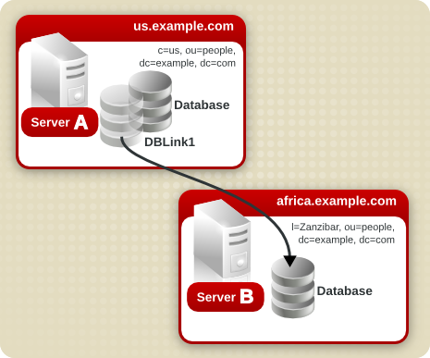
Creating Database Links

Slide 28
Database links
An Oracle Database link is an object that gives you visibility into another database
Synonyms can be used to mask the location of the table or view. The source data can reside in a totally different database. Data from another database is accessed using a database link
Like a synonym, the keyword PUBLIC makes the database link available to all users in the database
When the CONNECT TO clause is used, it specifies the username and password that will be used to establish a session in the remote database

Slide 29
exmaples
CREATE PUBLIC DATABASE LINK new_jersey
CONNECT TO home_office IDENTIFIED BY secret USING 'NJ';
OR HIDE PASSOWRDS
CREATE PUBLIC DATABASE LINK new_jersey USING 'NJ';

Slide 30
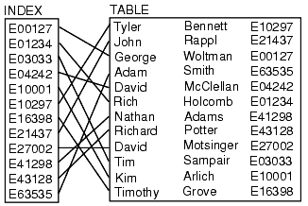
Next time
Packages
Creating and Managing Indexes

Slide 31

assignment
Only for creative people
Copiers go home
Only your ideas
Nothing and I mean nothing should be copied
You
You
You
You
You
Okay I think you got it
Could be your only way to “A”
No specific marks (I’ll give for whom ever I feel deserve it)
The winner will be happy and join Caption Sparrow in his next expedition
Make an info graph for all topics talked about today and will talk about next week (indices and packages)

Slide 32


